Slide 1
Sign Up
Log-in
First Name
Last Name
User Name
Department
Mobile No
Password
Password
Password
Log-In
Designation
Photo
Sign Up

Slide 2







User Name
Picture Slide Show

Slide 3
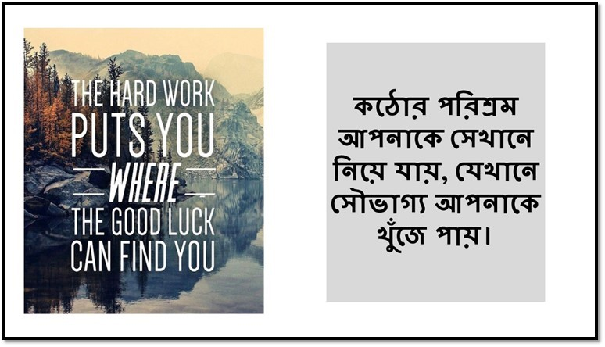


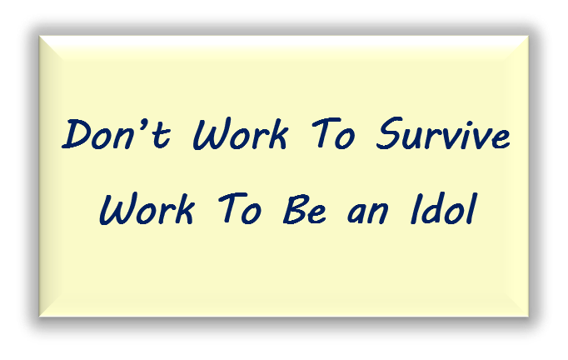
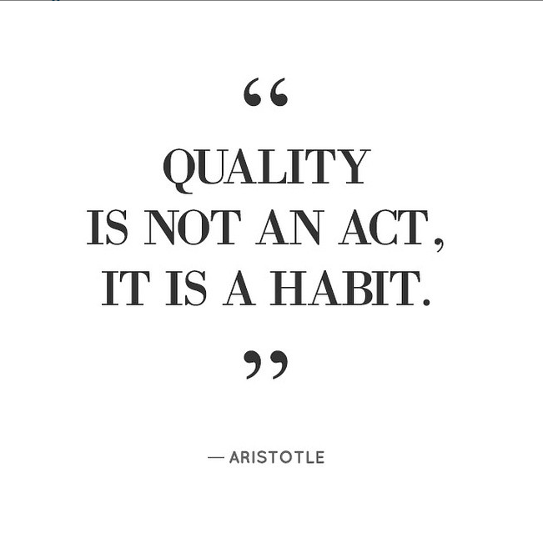
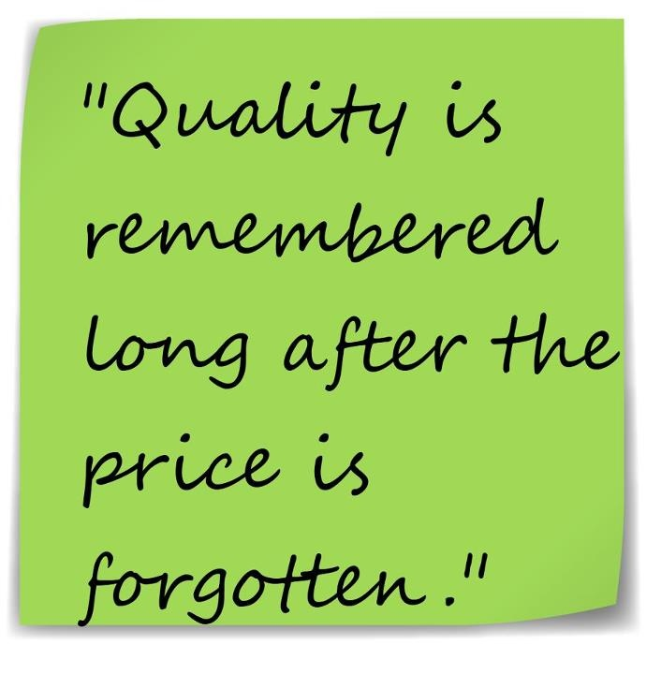
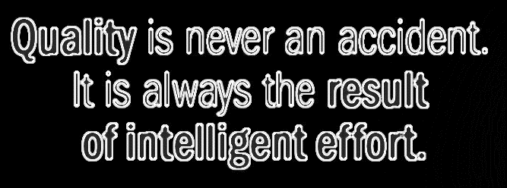
Mission
Secure product quality as per customer demand.
Maintain functionality of routine & Requirement.
Sustain on high quality standard.
Ensure Safe & Secure quality work.
Make Sure the Most precise work.
Vision
Stablish zero defect Method.
No Stop Order.
No Customer Claim.
Create Best Quality Standard.
Be an Idol on Quality.

Slide 4
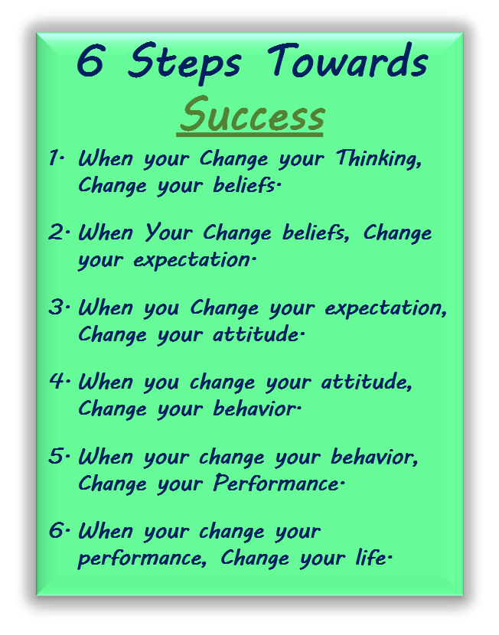
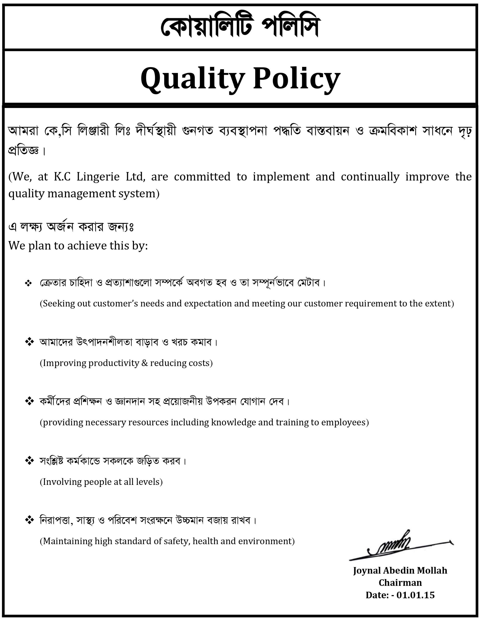

Slide 5
Your
Profile
My
Profile
Detail Contact Info.
Detail Contact Info.

Slide 6

Job Description
SOP & Flow Chart
Routine & Method
Head Of Quality
Deputy Manager (Quality)
Asst. Manager (Quality)
Sr. Quality Executive
Quality Executive
GPQ
Sr. Auditor / Auditor Quality
MIS Officer
In-charge (Quality)
Sr. QC
QC
Supervisor (Check)
Line QC
QI / Ord. QI
Reporter
Loader
Spot Remover
Quality Manual
Job Description
SOP & Flow Chart
Routine & Method
H&M Education
Quality Reports

Slide 7

Field of Excellence

Slide 8
Certified By

Slide 9

Our Team
Photo
Mahbubur Rahman Russell
Authority of KC Lingerie Ltd.
Photo
Hamidur Rahman Hamid
Head of Production
Jowel Hossain
Head of Quality
Photo

Slide 10
Photo
Ariful Islam Sajib
Responsible (Business)
Ariful Islam Shanto
Responsible (Business)
Photo
Photo
Ariful Islam Arif
Responsible (Business)
Rajiv Hossain
Responsible (HR & Admin)
Photo
Photo
Sholayman Kabir
Responsible (HR & Compliance)
oooo
Responsible (QS)
Photo

Slide 11
Photo
Mohammad Sayed
Responsible (NQC)
Arif Hossain
Responsible (CAD)
Photo
Photo
Mamunur Rashid
Responsible (Sample)
Salauddin Ahmed Rakib
Responsible (IE & Planning)
Photo
Photo
Osman Gony Mithu
Responsible (IE)
Mostafizur Rahman
Responsible (Material)
Photo

Slide 12
Photo
Moshiur Rahman
Responsible (Cutting)
Nur-A-Alom Milton
Responsible (Maintenance)
Photo
Photo
Shohidul Kobir
Responsible (Enovation Team)
Shahidul Islam
Responsible (Production)
Photo
Photo
Hafizur Rahman Hafiz
Responsible (Production)
Shafiqul Islam
Responsible (Quality)
Photo

Slide 13
Photo
S.M. Mazharul Islam
Responsible (Quality)
Mostafa Jalal
Responsible (Finishing)
Photo
Photo
Mirza Mamunur Rashid
Responsible (MQAC)

Slide 14
COO Sir
Please Follow This Chart During Making of Our Team for Alignment.
Head of Production
Head of Quality
Business
Business
Business
HR & Admin
HR & Compliance
QS
NQC
CAD
Sample
IE & Planning
IE
Store
Cutting
Maintenance
Enovation Team
Production
Production
Quality
Quality
Finishing
MQAC

Slide 15
Photo
Mahbubur Rahman Russell
Authority of KC Lingerie Ltd.
Email: - russell@knitconcern.com
Phone: - +880 1713-000533
About: - Authority of KC Lingerie Ltd. Dynamic, Innovative & Constructive solver of any kind of difficulties. Excellent experienced in Marketing, Business, Management, Technical & Ethics. Wish to dream the develop of company and is determined to make it a reality. Leading Subordinate for a better future & to be self dependent.

